Slide 1

Tech Layoff 2022
Cs 573 |PROF. Omid dehzangi
by Voke Brume

Slide 2

Agenda
Introduction
Goal
Exploration
Models
Conclusion
References

Slide 3
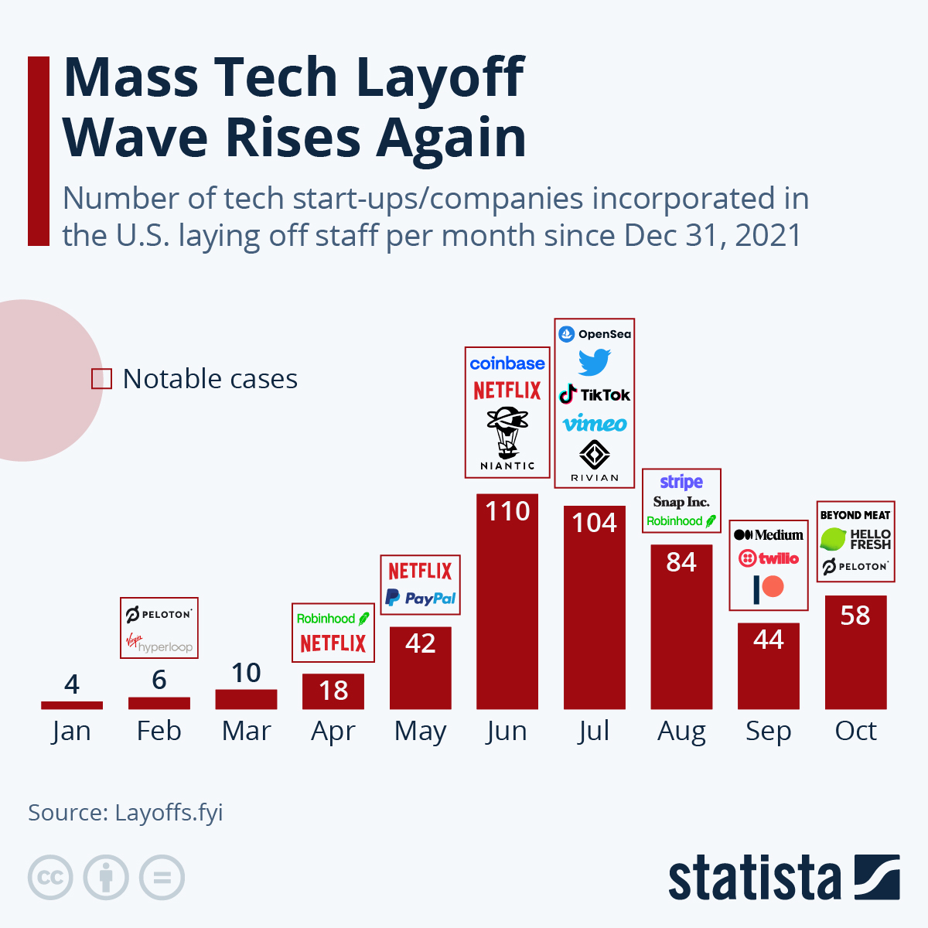
Introduction
The year 2021 saw continuous growth for tech start-ups and giants. However, over the course of the year 2022, tech companies like Meta, Uber, Netflix, and Twitter have made news for laying off thousands of workers. As of late November, more than eighty-five thousand (85,000) workers in the U.S tech sector have been laid off in mass job cuts (Crunchbase News Tally)

Slide 4

Goal
This report aims to:
Analyze the recent layoffs in the tech sector to discover useful insights.
Examine the trends in the data.
Compare the performance of multiple time series models on the data set

Slide 5

Data
The data for this project was compiled by Roger Lee on his website layoffs.fyi. The website uses Airtable to display tech layoffs since the start of COVID-19 pandemic in 2020. The data is compiled from public reports as seen in Bloomberg, San Francisco Business Times, TechCrunch, and The New York Times, and is updated every week. For this project, the data set contains layoffs from March 11, 2020, to November 30, 2022.

Slide 6
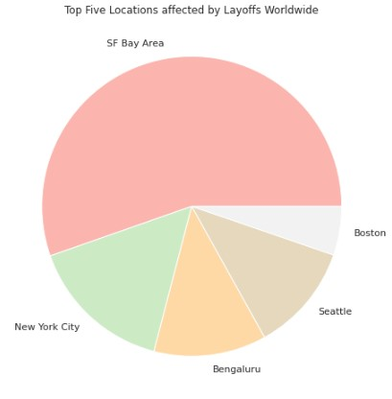
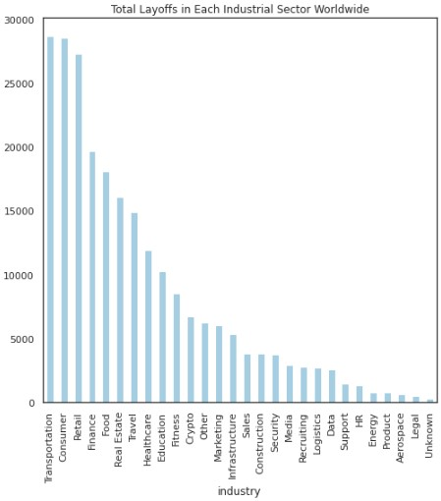
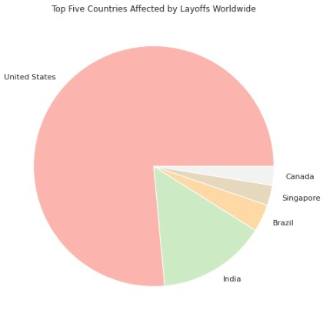
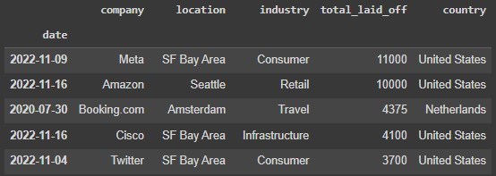
Exploration
U.S has the highest number of tech layoffs globally, followed by India
Tech employees in the Transportation, Consumer, Retail, and Finance industries were laid off the most while sectors like Legal, Aerospace, Product, and Energy experienced less layoffs.
Tech workers in the Data industry experienced fewer layoffs than most.
Tech companies in the San Francisco Bay Area have laid off the most employees compared to other locations around the world
Meta and Amazon have laid off the most tech employees globally
Fig. 1: Layoffs Worldwide by Location
Fig. 3: Layoffs Worldwide by Industry
Fig. 2: Layoffs Worldwide by Country
Fig. 4: Companies with most layoffs

Slide 7
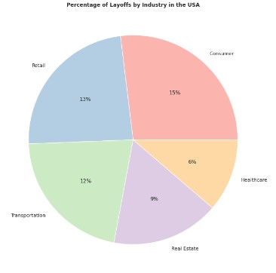
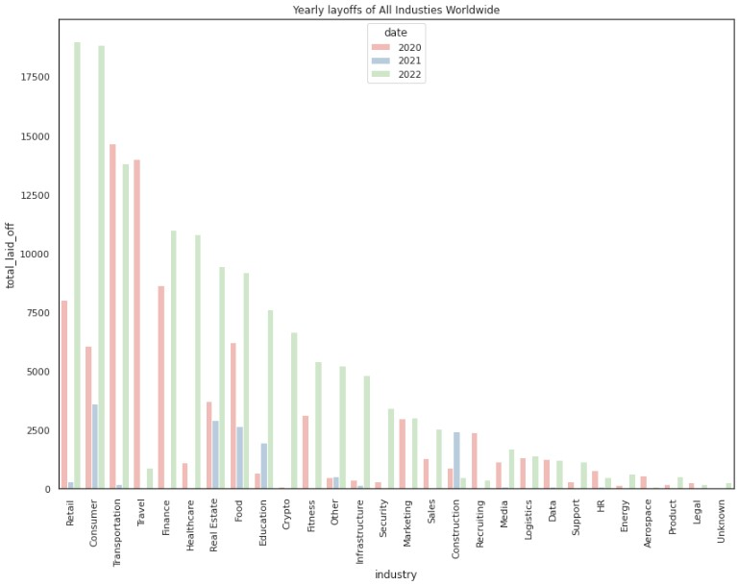
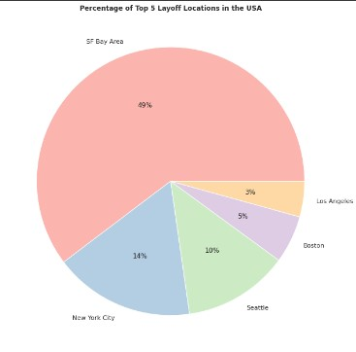
Exploration
Transportation and Travel industries were hit hard at the start of the COVID pandemic, causing the highest layoffs of tech employees in 2020
In The USA, tech employees in the consumer industry are the most vulnerable to layoffs
San Francisco Bay Area tech employees are at high risk of being laid off
Very few tech employees were laid off in 2021
Fig. 6: Percentage of USA Layoffs by Industry
Fig. 5: Layoff worldwide of years by industry
Fig. 6: Percentage of USA Layoffs by Location

Slide 8

Model
The lack of a large dataset spanning an elongated period suggests long term memory may not be needed for the project. For comparison purposes, a Recurrent Neural Network (RNN) is used for forecasting. Its performance is then compared to Gated Recurrent Unit (GRU) and Long-Short Term Memory (LSTM).

Slide 9
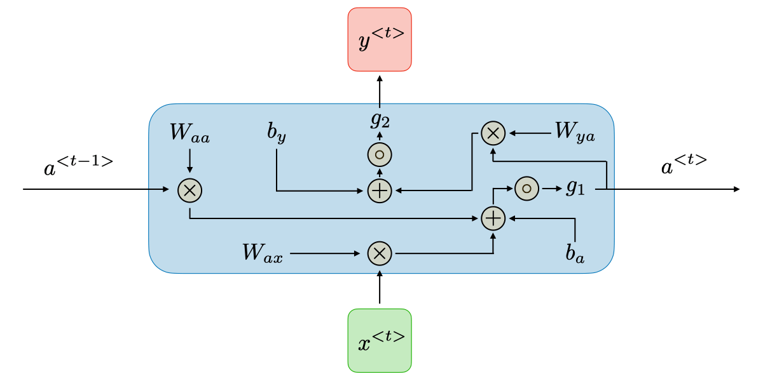
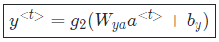
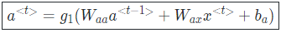
Recurrent Neural Network(RNN)
Recurrent neural networks, also known as RNNs, are a class of neural networks that allow previous outputs to be used as inputs while having hidden states.
Advantages include its ability to consider historical information and its weights are shared across time.
Drawbacks are slow computation, difficulty accessing information from a long time ago, inability to consider future input for the current state, and vanishing/exploding gradient.
Fig. 8: Computational Graph of RNN
Source: https://stanford.edu/~shervine/teaching/cs-230/cheatsheet-recurrent-neural-networks

Slide 10
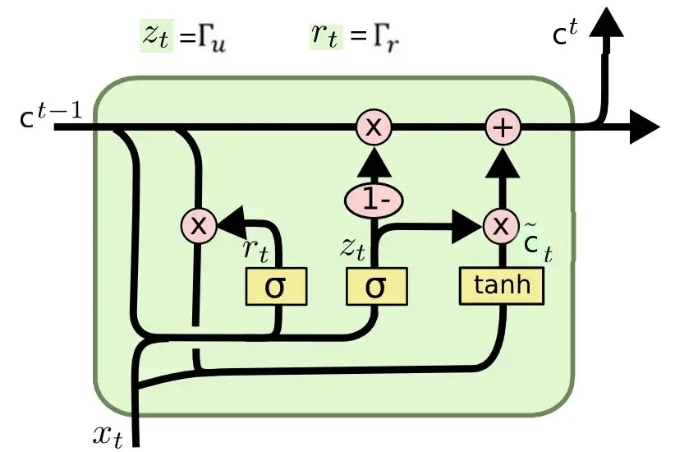
Gated Recurrent Unit (GRU)
GRU is a specialized version of RNN, but the difference is in the operations inside the GRU unit.
GRU has two gates (neural networks) each with its own set of weights and biases, the reset gate, and the update gate.
The update gate decides if the cell state should be updated with the current activation value or not, while the reset gate is used to decide whether the previous cell state is important or not.
Fig. 9: Basic Architecture of GRU
Source: https://medium.com/analytics-vidhya/rnn-vs-gru-vs-lstm-863b0b7b1573

Slide 11
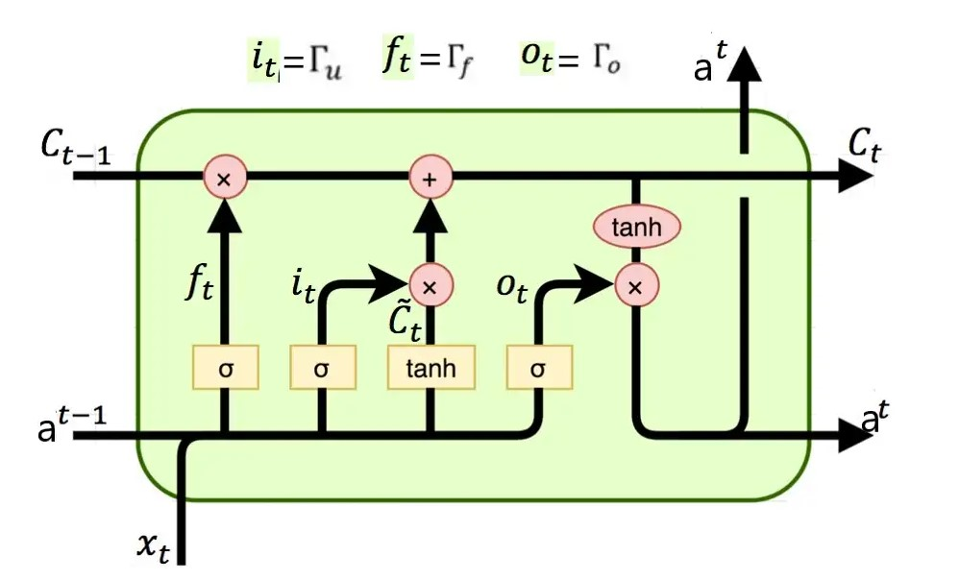
Long-Short Term Memory (LSTM)
LSTM is a variety of recurrent neural networks (RNN) that is capable of learning long-term dependencies, especially in sequence predicting problems.
Additional to GRU, LSTM also has a forget gate and output gate.
Forget gate controls what is kept vs forgotten from previous cell state, while the output gate controls which parts of the cell are output to the hidden state, thereby determining what the next hidden state will be.
Fig. 10: Basic Architecture of LSTM
Source: https://medium.com/analytics-vidhya/rnn-vs-gru-vs-lstm-863b0b7b1573

Slide 12
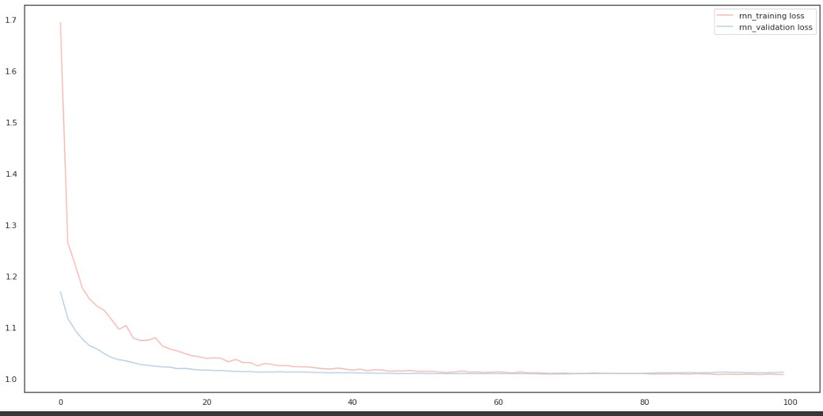
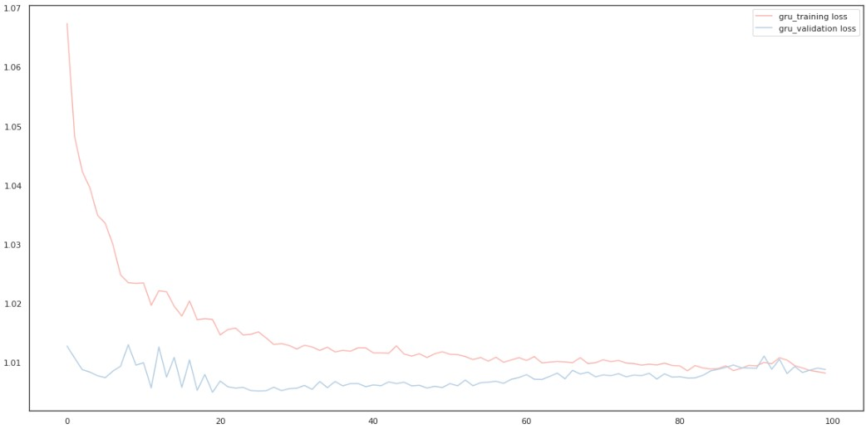
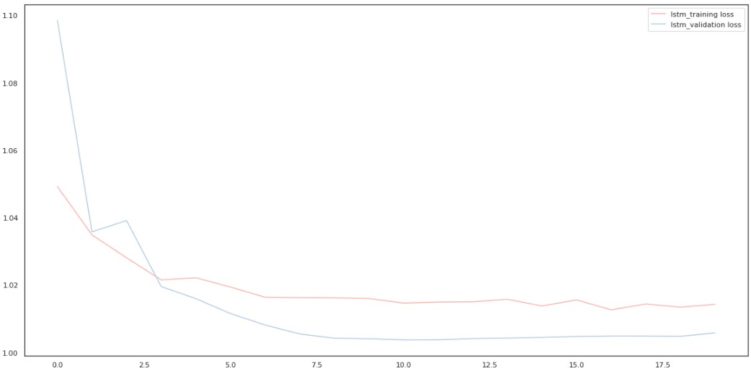
Results
Fig. 11. RNN
RNN was fastest to train, followed by GRU, then LSTM
All three models performed well on the data set, but it can be observed that in 20 epochs, LSTM yielded a more stable result than RNN and GRU did in 100 epochs. Also, LSTM shows less loss than RNN and GRU.
Fig. 12. GRU
Models (After 20 epochs) | Train Loss | Validation Loss
RNN | 1.0434 | 1.0178
GRU | 1.0173 | 1.0050
LSTM | 1.0143 | 1.0037
Fig. 13. LSTM
Fig. 14. Performance measures after twenty (20) epoch

Slide 13
Conclusion
There exploration segment of this report showed a lot of interesting information such as:
U.S has the highest number of tech layoffs globally, followed by India. Tech workers in the Data industry experienced fewer layoffs than most.
Tech companies in the San Francisco Bay Area have laid off the most employees compared to other locations around the world
Meta and Amazon have laid off the most tech employees globally Transportation and Travel industries were hit hard at the start of the COVID pandemic, causing the highest layoffs of tech employees in 2020
In The USA, tech employees in the consumer industry are the most vulnerable to layoffs
San Francisco Bay Area tech employees are at high risk of being laid off
Also, all three models performed well on the data set, but it can be observed that in 20 epochs, LSTM yielded a more stable result than RNN and GRU did in 100 epochs.

Slide 14
Future Work
Update the data to a more recent version
Perform more exploration to gain additional insights

Slide 15
References
Florian Zandt, 2022. Statista: Mass Tech Layoff Wave Rises Again. https://www.statista.com/chart/27964/number-of-tech-start-ups-companies-incorporated-in-the-us-laying-off-staff-per-month/
Keerthi Vedantam, 2022. Crunchbase News: Tech Layoffs in 2022: The U.S Companies that have Cut Jobs. https://news.crunchbase.com/startups/tech-layoffs-2022/
Roger Lee, 2022. Data Source: https://layoffs.fyi/
Shervine Amidi, 2022. Recurrent Neural Networks. https://stanford.edu/~shervine/teaching/cs-230/cheatsheet-recurrent-neural-networks

Slide 16

Thank you!

